Slide 1
Predicting weather caused train delays
CS-E5710-Bayesian_Data_Analysis project
Team InterCity
Viet Nguyen, Roope Tervo

Slide 2

Image: Solita Oy
Notes:
Train delays are important to predict so that rail traffic operations center are able to prepare (put more workforce on field, reduce train shifts)
Most of severe train delays are caused by bad weather
The issue has been studied only a little, one similar study has been done in Northern Italy
They was able to predict train delays based on few weather parameters using methods based on Random Forests

Slide 3
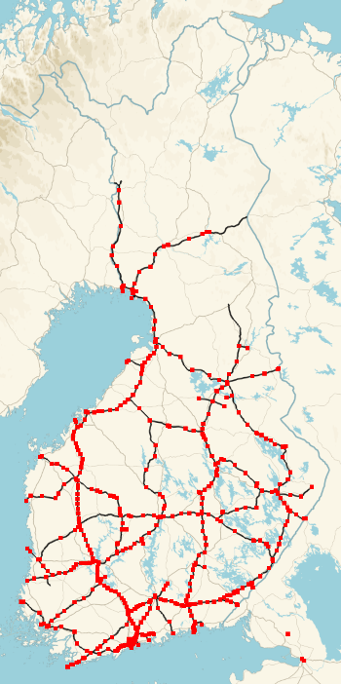
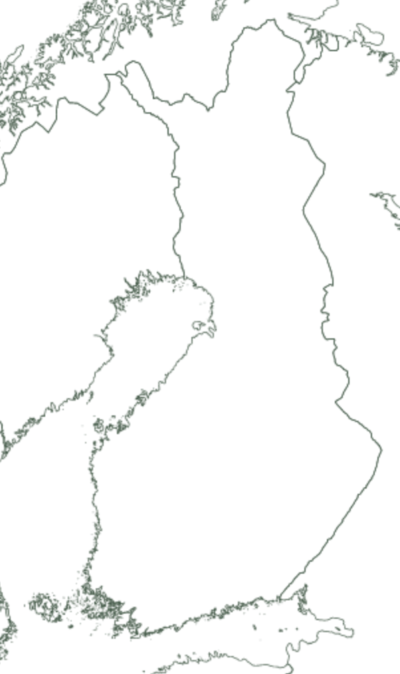

Label data consists of trains delayed between stations
End: +6 min
Data from 2010 – 2018
1 station (Helsinki)
99 014 rows
Only passenger trains considered
Mid 2: +12 min
Mid 1: +0 min
Start: +0 min
Image: Roope Tervo 2018, license CC4, Data Liikennevirasto (CC4)
Image: Roope Tervo 2018, license CC4, Data Maanmittauslaitos (CC4)
Notes:
Our dataset is got from Finnish Traffic Agency (FTA)
The dataset contains train delay information from 2010 to 2018 and corresponding weather information
All trainstations
4 different train types
In total almost 30 million rows
19 weather parameters
We use here only Helsinki railway station and passenger trains

Slide 4
We used bayesian linear regression to model delays
Description of the model

Slide 5
5 parameters selected to as features
Temperature, snow depth, wind gust, wind direction, visibility
Selection done both based on histogram analysis and assumptions on remarkable parameters
Notes:
We picked 7 parameters to as features
Selection was done partly based on assumptions on remarkable parameters and based on histogram analysis
In the example images:
blue stands for all cases in the dataset (for current parameters)
red stands for rows with over 50 minutes accumulated delay (= sever rail traffic disruption)
Difference in histograms gives a hint that the particular parameter affects on train traffic
We also tried one model with fewer parameters (temperature, snow depth, wind direction, 6h precipitation sum)

Slide 6
Non informative and informative prior were expreminented
Description of the prior choices
Notes:
We picked 7 parameters to as features
Selection was done partly based on assumptions on remarkable parameters and based on histogram analysis
In the example images:
blue stands for all cases in the dataset (for current parameters)
red stands for rows with over 50 minutes accumulated delay (= sever rail traffic disruption)
Difference in histograms gives a hint that the particular parameter affects on train traffic

Slide 7
Models converged well
Convergence analysis
Notes:
We picked 7 parameters to as features
Selection was done partly based on assumptions on remarkable parameters and based on histogram analysis
In the example images:
blue stands for all cases in the dataset (for current parameters)
red stands for rows with over 50 minutes accumulated delay (= sever rail traffic disruption)
Difference in histograms gives a hint that the particular parameter affects on train traffic

Slide 8
Fitted model do not represent observed data
Posterior predictive checking
Notes:
We picked 7 parameters to as features
Selection was done partly based on assumptions on remarkable parameters and based on histogram analysis
In the example images:
blue stands for all cases in the dataset (for current parameters)
red stands for rows with over 50 minutes accumulated delay (= sever rail traffic disruption)
Difference in histograms gives a hint that the particular parameter affects on train traffic

Slide 9
Statement about model comparison…
…
Notes:
We picked 7 parameters to as features
Selection was done partly based on assumptions on remarkable parameters and based on histogram analysis
In the example images:
blue stands for all cases in the dataset (for current parameters)
red stands for rows with over 50 minutes accumulated delay (= sever rail traffic disruption)
Difference in histograms gives a hint that the particular parameter affects on train traffic

Slide 10
Statement about sensitivity
Sensitivity analysis
Notes:
We picked 7 parameters to as features
Selection was done partly based on assumptions on remarkable parameters and based on histogram analysis
In the example images:
blue stands for all cases in the dataset (for current parameters)
red stands for rows with over 50 minutes accumulated delay (= sever rail traffic disruption)
Difference in histograms gives a hint that the particular parameter affects on train traffic

Slide 11
The model has no real prediction skill
* Predictive performance assesment
Notes:
We picked 7 parameters to as features
Selection was done partly based on assumptions on remarkable parameters and based on histogram analysis
In the example images:
blue stands for all cases in the dataset (for current parameters)
red stands for rows with over 50 minutes accumulated delay (= sever rail traffic disruption)
Difference in histograms gives a hint that the particular parameter affects on train traffic

Slide 12
Different methods are required to predict weather caused train delays
Still, other methdos has been succesfully used for the prediction
At least different model is required
Time series model (like bsts)
Random Forests
Bayesien models may be problematic because whole data can’t easily be used
Bad weather cases are rare, how to catch them?
Gaussian processes with inducing points?
Notes:
We picked 7 parameters to as features
Selection was done partly based on assumptions on remarkable parameters and based on histogram analysis
In the example images:
blue stands for all cases in the dataset (for current parameters)
red stands for rows with over 50 minutes accumulated delay (= sever rail traffic disruption)
Difference in histograms gives a hint that the particular parameter affects on train traffic

